Slide 1

Week 5 FDR Alignment

Slide 2
Our typical RNA quantification pipeline
Upload your
sequence data (fastq)
Make report of quality metrics
Output ribosomal contamination metrics report
Align to the ribosome (Bowtie)
Produce RNA-Seq report
% aligned, % intergenic, % exonic, % UTR
Align remaining reads to genome (TopHat) or transcriptome (RSEM)
Produce IGV/UCSC friendly files
Quantify transcriptome
Produce a table with normalized expression values
Call differentially expressed genes
(if multiple samples)
Report pairwise significant genes that are differentially expressed

Slide 3
Alignment requires pre-processing
Upload your
sequence data (fastq)
Make report of quality metrics
Output ribosomal contamination metrics report
Align to the ribosome (Bowtie)
Align remaining reads to genome (TopHat) or transcriptome (RSEM)
Last meeting:
What is a genome index
How it is used to speed up short read mapping
What is mapping quality
bowtie2-build -f mm10.fa mm10
rsem-prepare-reference \
--gtf ucsc.gtf --transcript-to-gene-map ucsc_into_genesymbol.rsem \
mm10.fa mm10.rsem

Slide 4
RNA-Seq Read mapping
Notes:
If you have a reference genome of high quality, mapping reads leverages this information. Most eukaryote transcripts result from splicing events. RNASeq reads come from molecules that map to the genome as small exons within several KBs of genomic sequence. This makes RNA-Seq reads particularly complex to map. RNASeq reads come in three flavors: Those that map to single exons, those that map to two or more spliced exons and those that contain portions of the PolyA tail. Mapping all three classes results in optimal, coverage, connectivity and transcript end mapping.

Slide 5
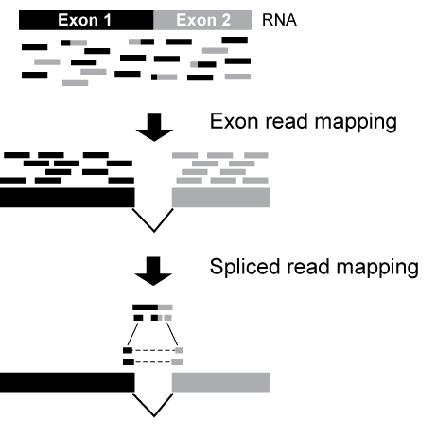
Mapping RNA-Seq reads: Exon-first spliced alignment (e.g. TopHat)

Slide 6
Short read alignment
Upload your
sequence data (fastq)
Make report of quality metrics
Output ribosomal contamination metrics report
Align to the ribosome (Bowtie)
Align remaining reads to genome (TopHat) or transcriptome (RSEM)
tophat2 --library-type fr-firststrand --segment-length 20 \
-G genome.quantification/ucsc.gtf -o tophat/th.quant.ctrl1 \
genome.quantification/mm10 fastq.quantification/control_rep1.1.fq \
fastq.quantification/control_rep1.2.fq
/project/umw_biocore/bin/igvtools.sh count -w 5 tophat/th.quant.ctrl1.bam \ tophat/th.quant.ctrl1.bam.tdf genome.quantification/mm10.fa

Slide 7
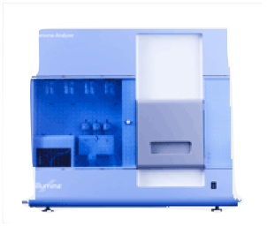

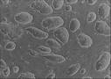
Once sequenced the problem becomes computational
sequencer
Sequenced reads
cells
cDNA
ChIP
Alignment
read coverage
genome

Slide 8
Considerations and assumptions
High library complexity
#molecules in library >> #sequenced molecules
Short reads
Read length << sequenced molecule length
Not all applications satisfy this:
miRNA sequencing
Small input sequencing (e.g. single cell sequencing)

Slide 9
A library satisfying assumptions 1 & 2
E(# f_{g}) = #reads *θg * l_{g}
f_{g} = Fragment from gene (transcript) g
θ_{g} = Fraction of gene g in sample
l_{g} = (effective) length of gene g

Slide 10
Corollaries
Libraries satisfying assumptions 1 & 2 only measure relative abundance
Key quantity: # fragments sequenced for each transcript. Need to:
Which transcript generated the observed read?
Isn’t this easy?
Reads do not uniquely map
Transcripts or genes have different isoforms
Sequencing has a ~ 1% error rate
Transcripts are not uniformly sequenced

Slide 11
The RNA-Seq quantification problem (simple case)
Start with a set of previous gene/transcript annotations
Assume only one isoform per gene
Assume 1-1 read to transcript correspondence.
(Sequencing depth)
Using the Poisson approximation to the binomial
We seek to maximize the likelihood of transcript frequencies given the data
Which, of course has MLE

Slide 12
The RNA-Seq quantification problem (more realistic case)
Start with a set of previous gene/transcript annotations
Assume Define only one isoform per gene
Assume 1-1 read to transcript correspondence. Reads (fragments) are now short, one transcript generates many fragments.
Change: Transcripts of different lengths generate
fragments
Transcript effective length
Model:
,
, with MLE:

Slide 13
The RNA-Seq quantification problem. Isoform deconvolution
Main difference: quantification involves read assignment. Our model must capture read assignment uncertainty.
Parameters: Transcript relative abundance
Latent variables: Fragment alignment source
Observed variables: N fragment alignments, transcripts, fragment length distribution

Slide 14
We can estimate the insert size distribution
P₁
P₂
Get all single isoform reconstructions
Splice and compute insert distance
d₁
d₂
Estimate insert size empirical distribution

Slide 15
… and use it for probabilistic read assignment
Isoform 1
Isoform 2
Isoform 3
d₂
d₁
d₁
d₂
P(d > d_{i})
For methods such as MISO, Cufflinks and RSEM, it is critical to have paired-end data

Slide 16
The RNA-Seq quantification problem. Isoform deconvolution
d₂
d₁
Parameters: Transcript relative abundance
Latent variables: Fragment alignment source
Observed variables: N fragment alignments, transcripts, fragment length distribution
Probability of the fragment alignment originating from t
Can be shown it is concave, and hence solvable by expectation maximization

Slide 17
Summary: Current quantification models are complex
In its simplest form we assume that reads can be unequivocally mapped. This allows:
Read counts distribute multinomial with rate estimated from the observed counts
When this assumption breaks, multinomial is no longer appropriate.
More general models use:
Base quality scores
Sequence mapability
Protocol biases (e.g. 3’ bias)
Sequence biases (e.g. GC)
Handling each of these involves a more complex model where reads are assigned probabilistically not only to an isoform but to a different loci

Slide 18
RNA-Seq libraries revisited: End-sequence libraries
Target the start or end of transcripts.
Source: End-enriched RNA
Fragmented then selected
Fragmented then enzymatically purified
Uses:
Annotation of transcriptional start sites
Annotation of 3’ UTRs
Quantification and gene expression
Depth required 3-8 mill reads
Low quality RNA samples
Single cell RNA sequencing

Slide 19
RNA-Seq libraries: Summary

Slide 20
End-sequencing solution

Slide 21
Analysis of counting data requires 3 broad tasks
Read mapping (alignment): Placing short reads in the genome
Quantification:
Transcript relative abundance estimation
Determining whether a gene is expressed
Normalization
Finding genes/transcripts that are differentially represented between two or more samples.
Reconstruction: Finding the regions that originated the reads

Slide 22
Sample composition impacts transcript relative abundance
Cell type I
Cell type II
Normalizing by total reads does not work well for samples with very different RNA composition

Slide 23
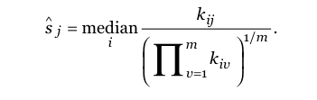
Example normalization techniques
Counts for gene i in experiment j
Geometric mean for that gene
over ALL experiments
i runs through all n genes
j through all m samples
k_{ij} is the observed counts for gene i in sample j
s_{j} Is the normalization constant
Alders and Huber, 2010

Slide 24
Lets do an experiment
Similar read number,
one transcript many fold changed
Size normalization results in 2-fold changes in all transcripts

Slide 25
When everything changes: Spike-ins
Lovén et al, Cell 2012

